Slide 1
NHS Identity
Authentication fit for modern health and social care
Presented by Neil Birch
Implementation Manager

Slide 2
NHS Identity – Overview
What is NHS Identity?
NHS Identity is a new Identity Management Service for NHS Staff Digital Identities
Will replace the current Care Identity Service (CIS)
Expected to run in parallel with CIS for 12-18 months
Why do we need it?
Current system is now 15 years old
Not easily scalable to future needs
Ongoing hosting and support cost
Access is limited to Smartcards on a Windows device over a N3/HSCN connection

Slide 3
NHS Identity - Why are we embarking on this?
A highly assured, secure, trusted national care worker digital identity
Supports different levels of identity assurance/authentication (IAL/AAL)
Enable Single Sign-on for seamless access into 3rd party Managed National Services e.g. NHS Mail, ESR
Simplify & Speed up the Logon experience
Support profile switching on supported devices
Enable Mobile Working - access anywhere, from any device, any platform, any browser
National Digital Signature service that conforms to e-IDAS rules
An alternative to Smartcards – provides local choice on how care-workers are authenticated
Simplified Registration process with self-registration options
Meets the Matt Hancock vision for digital services

Slide 4
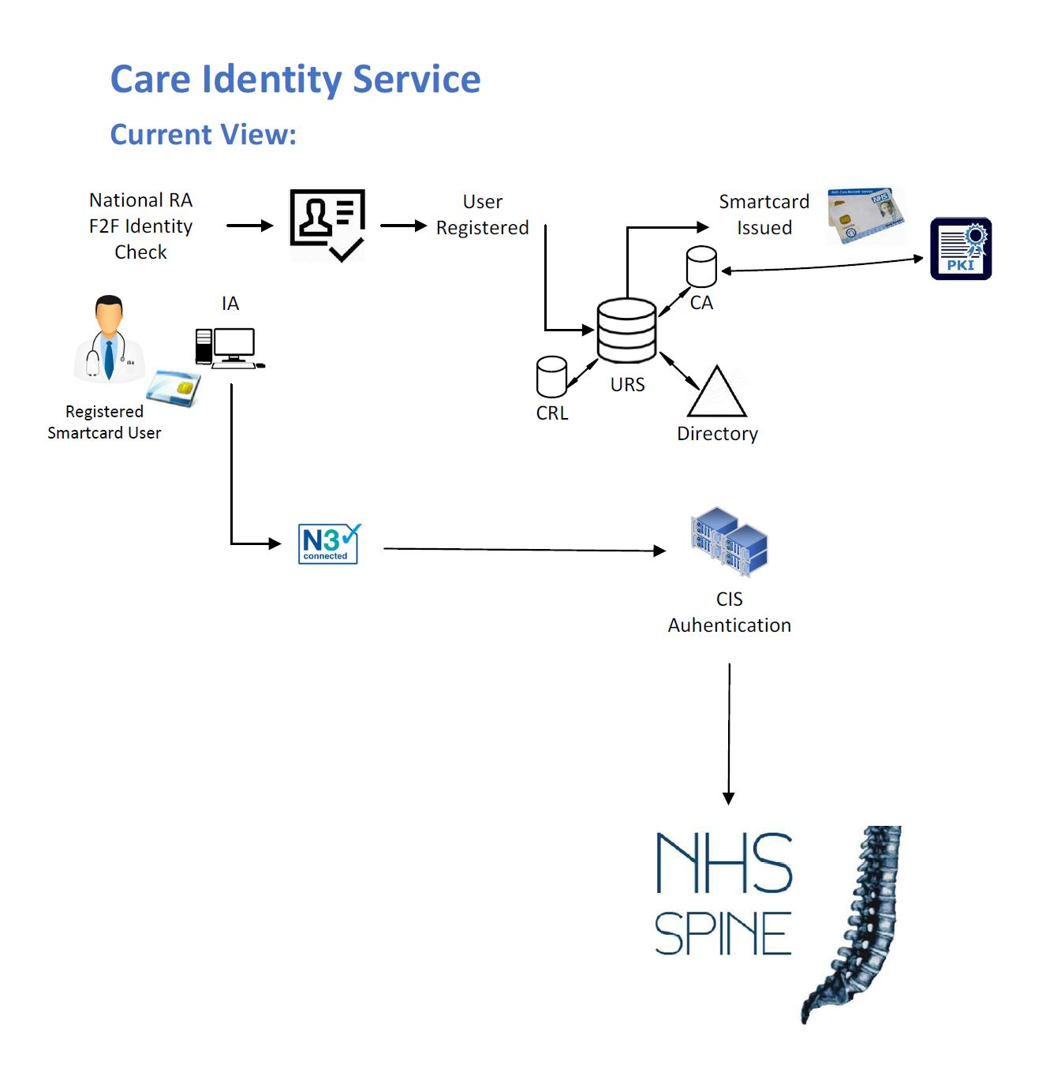
NHS Identity / CIS – Quick Comparison
The Care Identity Service
Single route into Spine
Requires Smartcard
Requires N3/HSCN network
Only runs on Windows
Requires Identity Agent and middleware installed on all Clients
Notes:
3 New national services will be built:
National Care Worker IDP – Will provide logon services at various levels depending on the organisation scenarios requirements. Initially Smartcard, OTP and Push Notification on service go live followed by FIDO based biometric support. Platform agnostic (e.g. ChromeOS)
National Access Gateway – Will protect national API’s and services referencing a granular rules and policies set
National Federation Service – Will allow the national signon to be used to access 3rd party national services such as NHSMail, O365 and ESR.

Slide 5
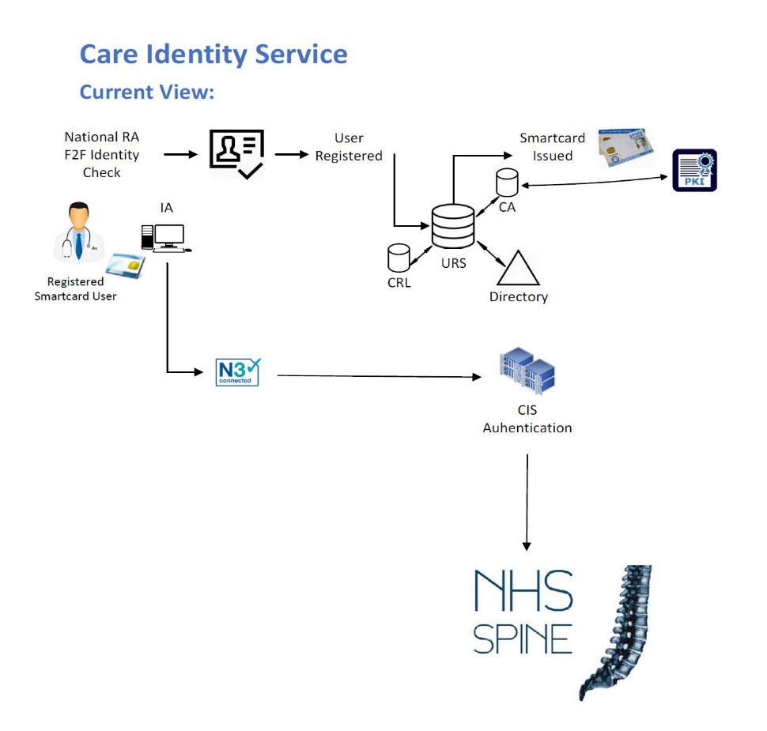
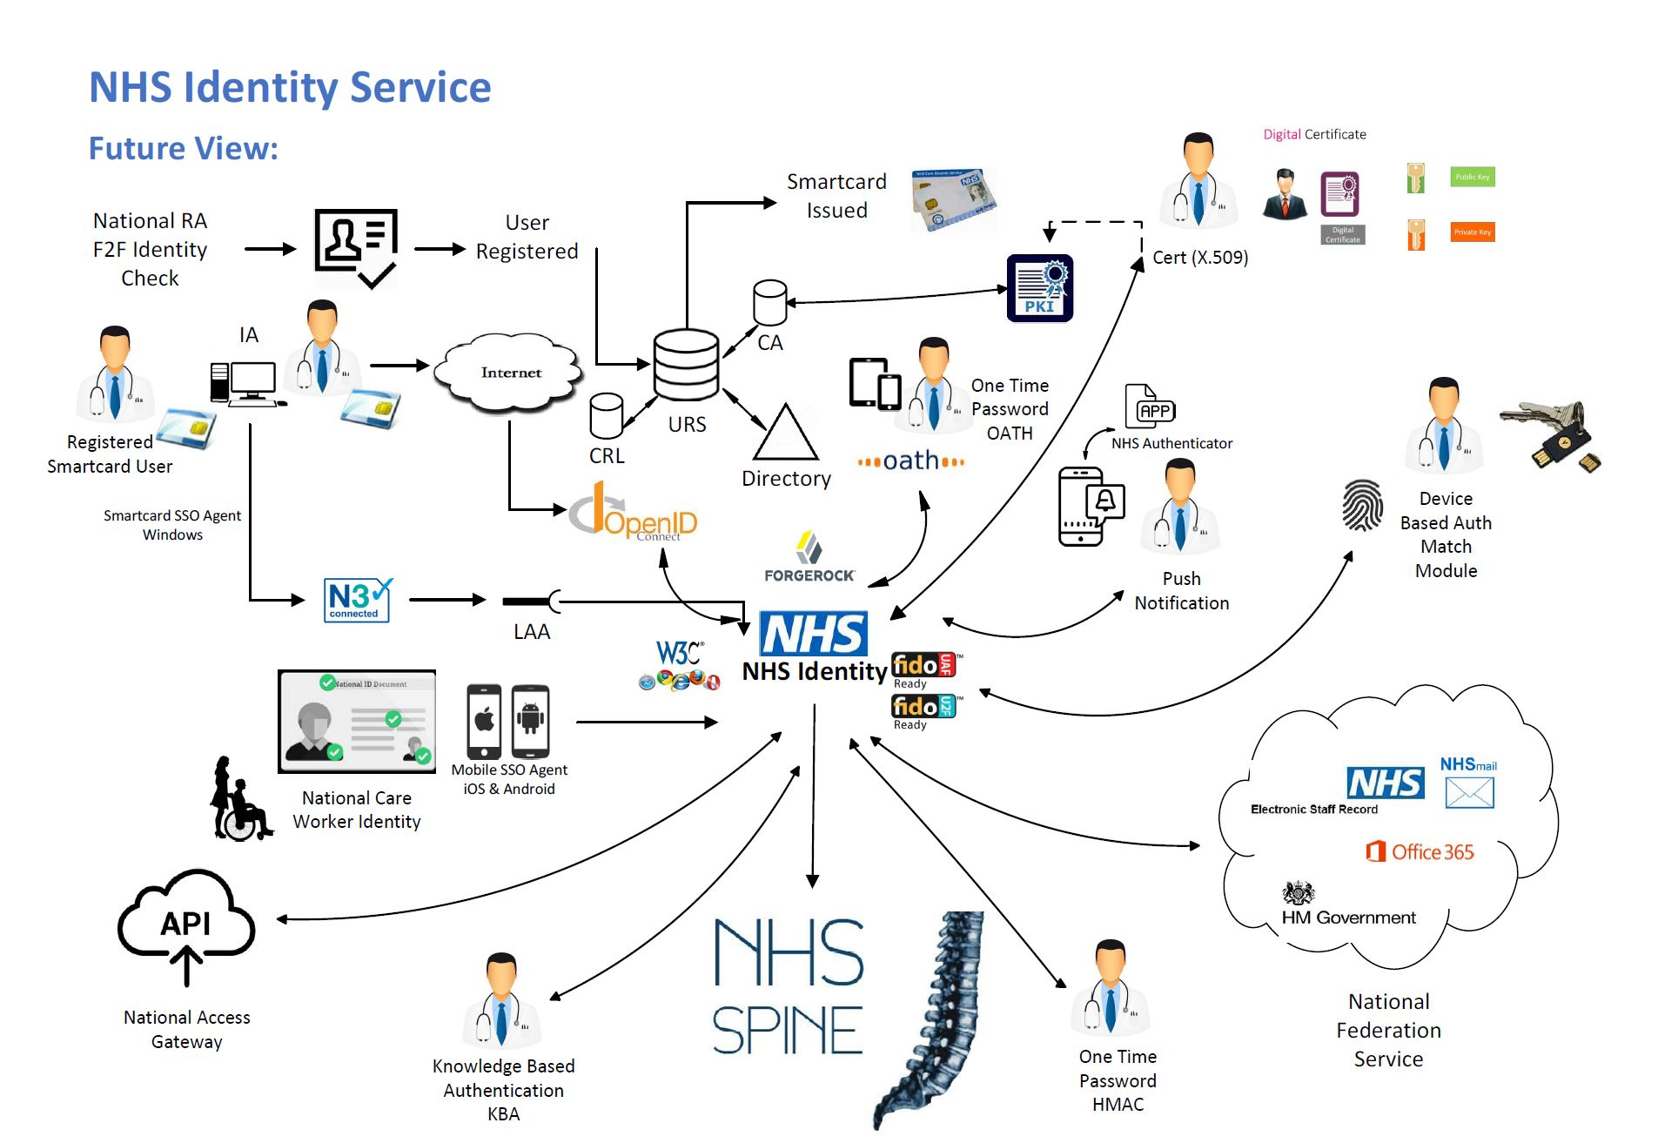
NHS Identity / CIS – Quick Comparison
NHS Identity
Available over the internet
No need for N3/HSCN
Available from device, any platform, any browser
Does not require Identity Agent
Notes:
3 New national services will be built:
National Care Worker IDP – Will provide logon services at various levels depending on the organisation scenarios requirements. Initially Smartcard, OTP and Push Notification on service go live followed by FIDO based biometric support. Platform agnostic (e.g. ChromeOS)
National Access Gateway – Will protect national API’s and services referencing a granular rules and policies set
National Federation Service – Will allow the national signon to be used to access 3rd party national services such as NHSMail, O365 and ESR.

Slide 6
NHS Identity – Some of the Tech Speak
OpenID Connect (Authentication)
OAUTH2 (Authorisation)
FIDO2 (Device Registration)
Federation (SSO)
Identity Assurance Levels (IALs 1-3)
Authenticator Assurance Levels (AALs 1-3)
Scopes and Claims

Slide 7
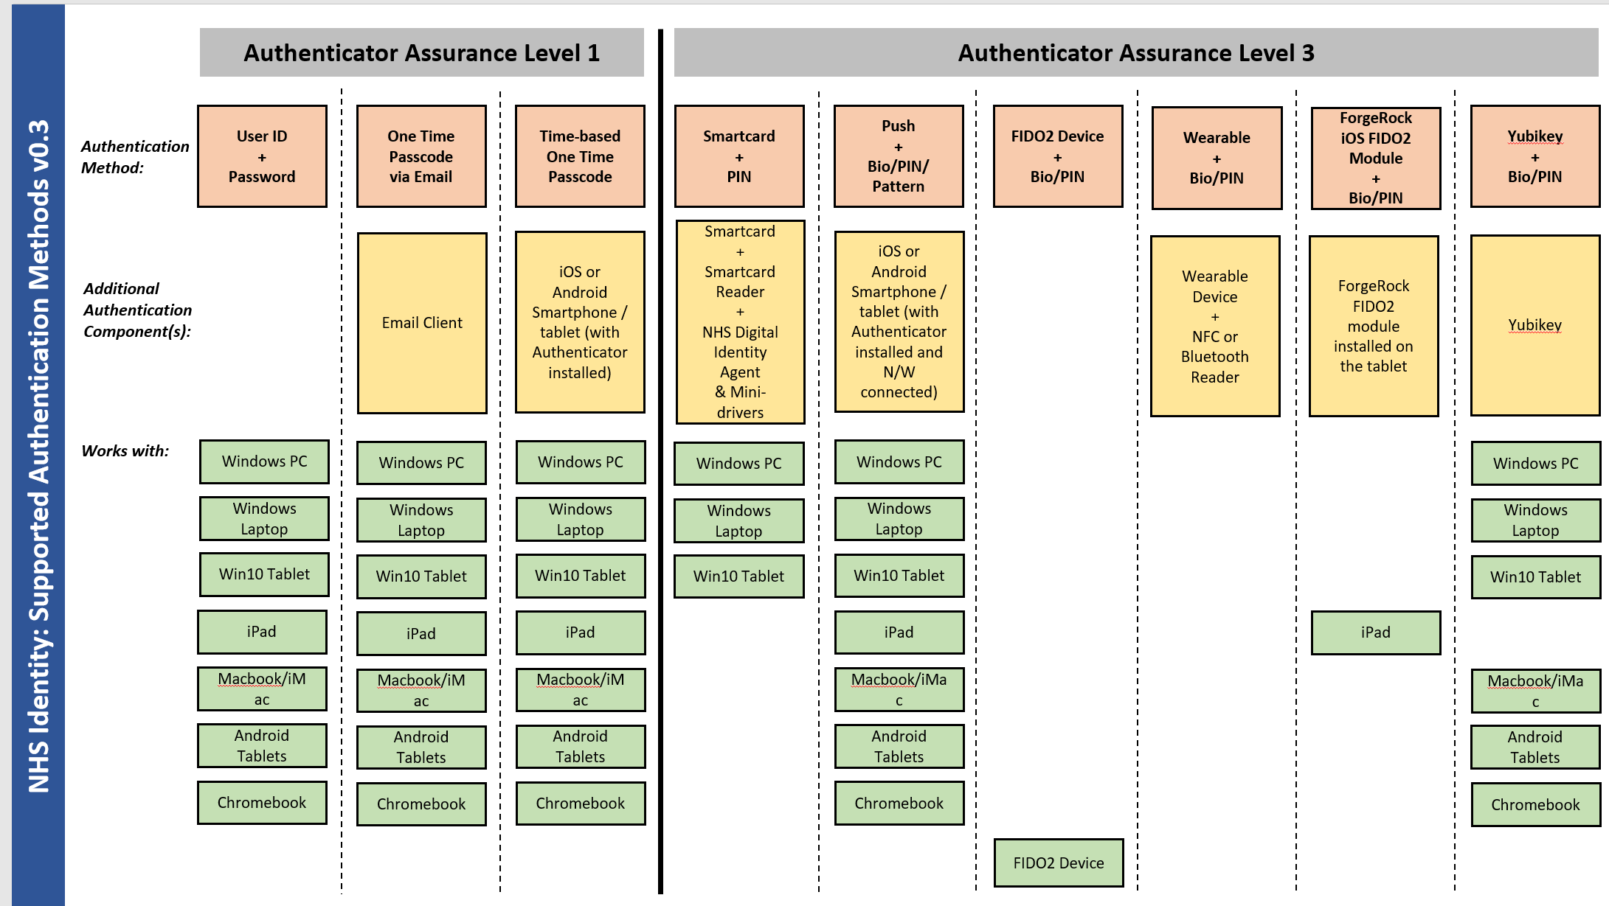
NHS Identity – supported devices

Slide 8
Definitions of Assurance/Authentication
NHS Identity supports 3 levels of authentication – level 3 required for clinical data
Based on Cabinet Office Good Practice Guides (43, 44, 45) will replace (e-Gif Level 3)
Advice from UK National Cyber Security Centre and US National Institute of Systems & Technology

Slide 9
NHS Identity – Roadmap 2018/19
First Service live on NHS Identity – Q1 (2018)
Platform builds/upgrades (inc Sandpit) – Q4 (2018)
Mobile access to Summary Care (SCRA) – Q1
OIDC for Smartcards – Q2
AAL1/AAL2 generic solution – Q3
FIDO2 registration of devices – Q4
DLP to platinum service – Q4
NRL phase 2
Federated Identity (SSO)
Digital Signing

Slide 10
NHS Identity - Long Term Roadmap Themes
Benefits
Simplifies Process
Increases Security
Benefits
Saves Time
Simplifies Process
Increases Security
Increases Security
Benefits
Single trusted digital identity signature
Saves time
Increases Security
Saves Money
Benefits
Saves time
Simplifies Process
Increases Security
Benefits
IOT Management
Benefits
Single trusted digital identity
Saves time
Increases Security
Enables Mobility
Simplify Logon
AI Continual Risk Analytics
User & Role Management
Remote Signature
Simple Registration
Next Gen Access Control
2017/2018
2019/2020
2019/2020
2019/2020
2020/2021
2020/2021

Slide 11
NHS Identity – interested?
For Further details:
Overview
Vision
Roadmap
Onboarding
Training Guides
Sandpit access
https://developer.nhs.uk/apis/national-authentication/
General Enquiries:
nhs.identity@nhs.net

Slide 12
Finally – a world without Passwords!

